Slide 1
Department : Department of Information and
Communication Technology.
Project Title : Contract Labor Source System
Presented By : Harshit Mangukiya (51)
Semester : 6th B.sc. (IT)
Faculty Guide : Prof. Lissa John
Academic Year : 2019-2020

Slide 2
Outline
Introduction of Project
Objective of Project
Scope of Project
Requirements
Tools & Technology Description
Modules Details
SRS
Diagrams
Screenshots

Slide 3
Introduction
The contract labor source system provides all types of labor information. By using this website, one can find suitable labor for a suitable job. Therefore, one will get more choices of labor as well as this website will generate more job opportunities for the labor. Due to, which will decrease poverty in our country.

Slide 4
Objective
This system is used to provide the labors detail.
This website will generate a lot of job opportunities for labor as well as customer will get labor anytime and anyplace.
This website provides various labor as your choice because it includes all types of labor in every area.
Contract labor source system is web based so it can be accessed from anywhere and anytime with basic internet connection.

Slide 5
Scope
Customer:-
Customer can register.
Customer can get available labor for particular job.
Customer can give review and rate the labor.
Labor:-
Labor can register.
Labor can set hourly charges according to work.
Labor can upload work related multiple image, video and related information.

Slide 6
Scope
Admin:-
This system can be easily handled through a single administrator.
Admin can view all user and labor profile.
Admin can manage users.

Slide 7
Requirements
Software requirements:
Sublime text editor.
Internet connection.
Web browser.
Server.
Hardware requirements:
512 MB ram.
20 GB hard disk.
Processor 1.3 GHz or higher

Slide 8
Tools & Technology Description
PHP programming language
MySQL
HTML5, CSS3, BootStrap
Ajax, jQuery and JavaScript
Google Chrome, Firefox

Slide 9
Modules
Login/Register:
Payment:
Search:
Hire Labor:
Rating/Review:
Profile Handling:

Slide 10
Login/Register
Register Themselves for the System.
Labor gives Aadhar Card ID as proof.
Admin Verify proof.
If admin gets any wrong information of labor then they will delete your account.
Labor and Customer Login to the Website.
Functionality of forget password is provided.

Slide 11
Payment
Using payment module, Customer easily buy membership package.
We have three membership package according to use.
Real basic
Real Standard
Real Ultimate

Slide 12
Search
Labor based searching
Location based searching.
Category based searching.

Slide 13
Hire Labor
Customers can hire labor according to their work that time labor will get a confirmation mail after that labor will confirm their job during this time customers will get payment mail, on the other hand, they can cancel their job as per some reasons during this period customer will get cancellation mail.
Customer can cancel labor jobs as per some reasons during this period labor will get cancellation mail.

Slide 14
Rating/Review
If customers hire labor and labor have given confirmation then the customer will give rating and review to labor.
If the customers did not get confirmation from labor then they will not give a rating and review.

Slide 15
Profile Handling
Users can edit the profile and make changes to the latest details.
Labor can add multiple work image as well as they can add work video.
Labor can set the status available or unavailable.

Slide 16
Software Requirements
Specification (SRS)

Slide 17
Diagram
ER Diagram
DFD Level-0
DFD Level-1
DFD Level-2
Use case Diagram

Slide 18
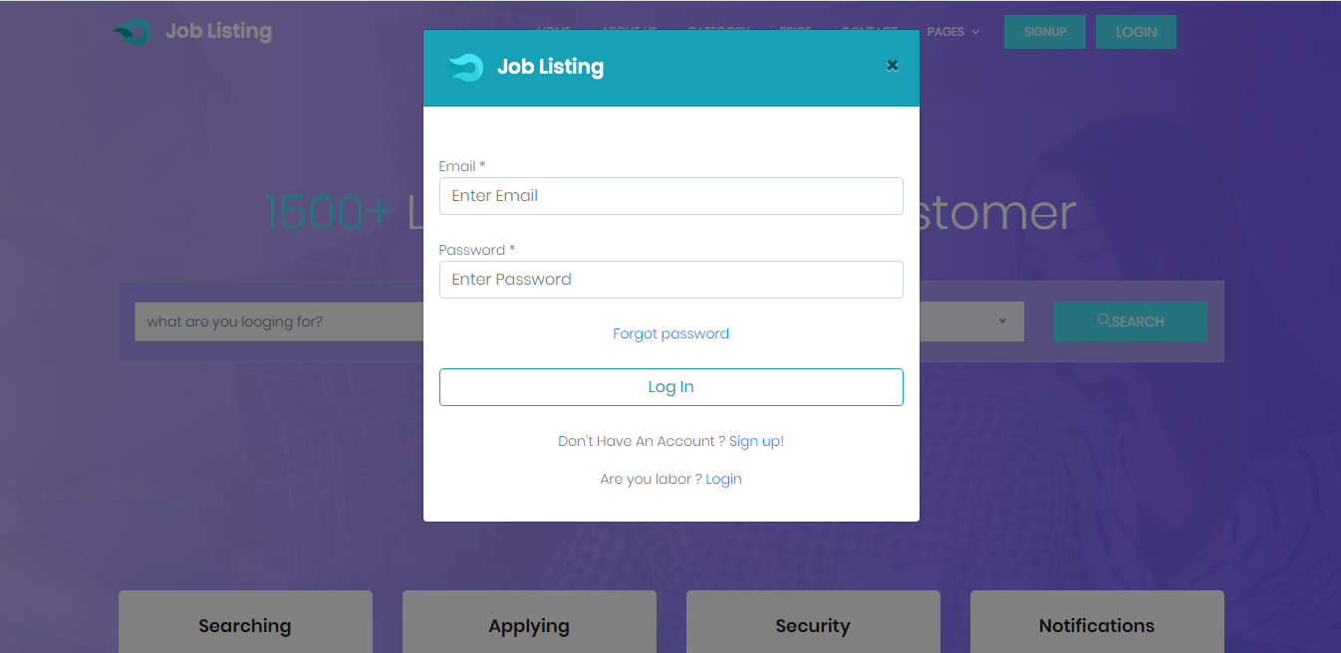
Fig 1. Login Screen

Slide 19
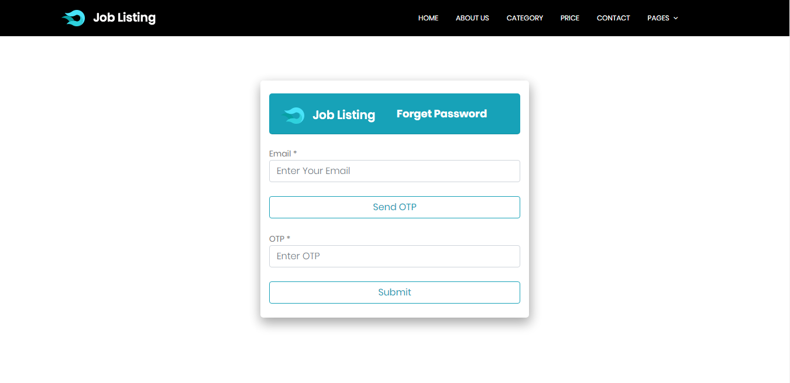
Fig 2. Forget Password Screen

Slide 20
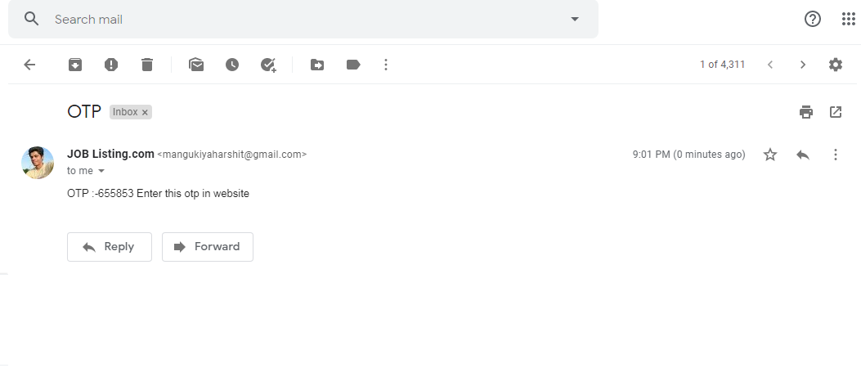
Fig 3. Email Screen

Slide 21
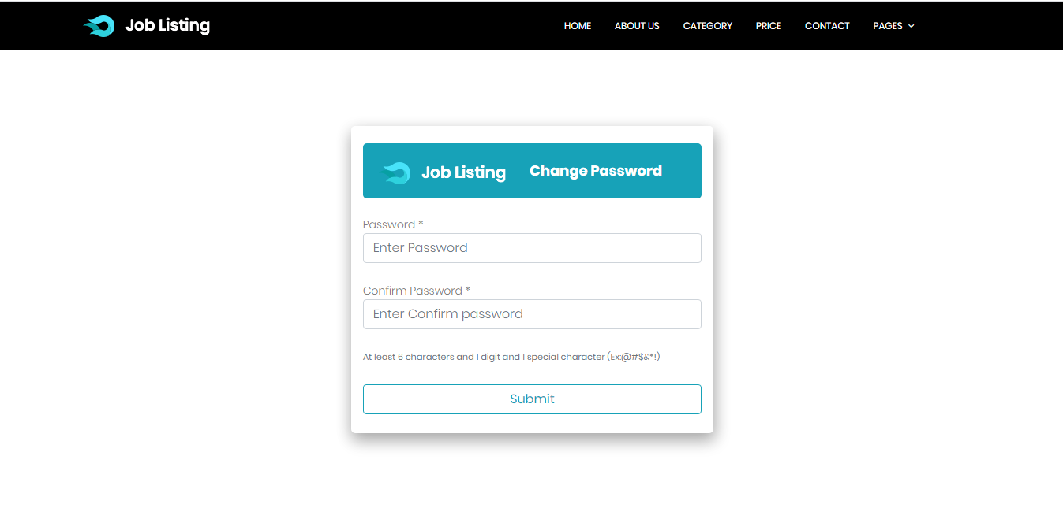
Fig 4. Change Password Screen

Slide 22
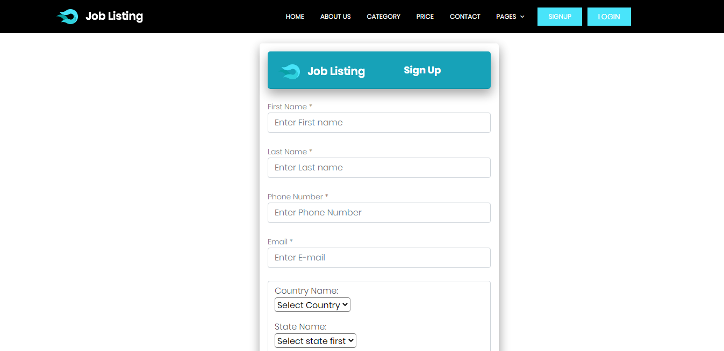
Fig 5. Sign Up Screen

Slide 23
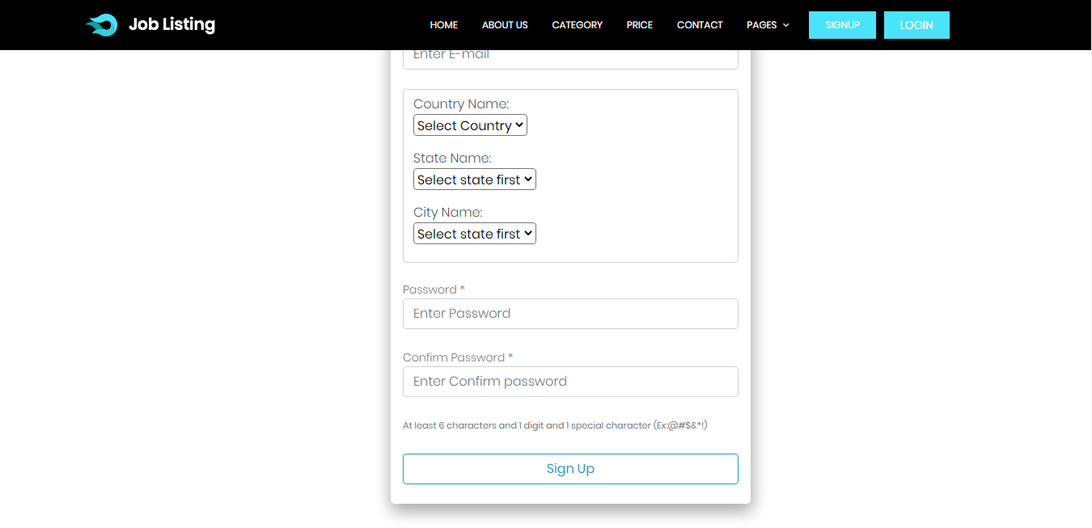
Fig 6. Sign Up Screen

Slide 24
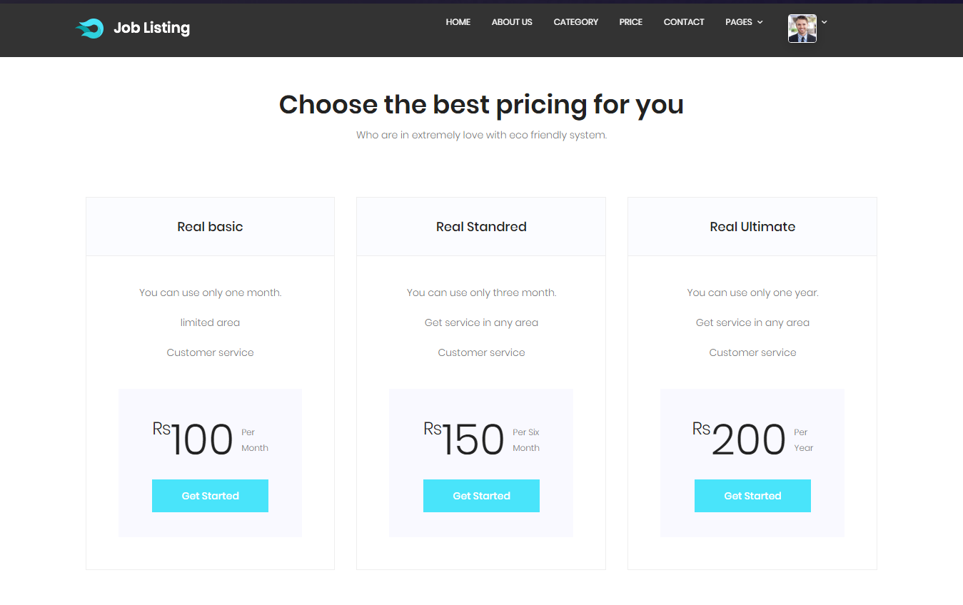
Fig 7. Price Screen

Slide 25
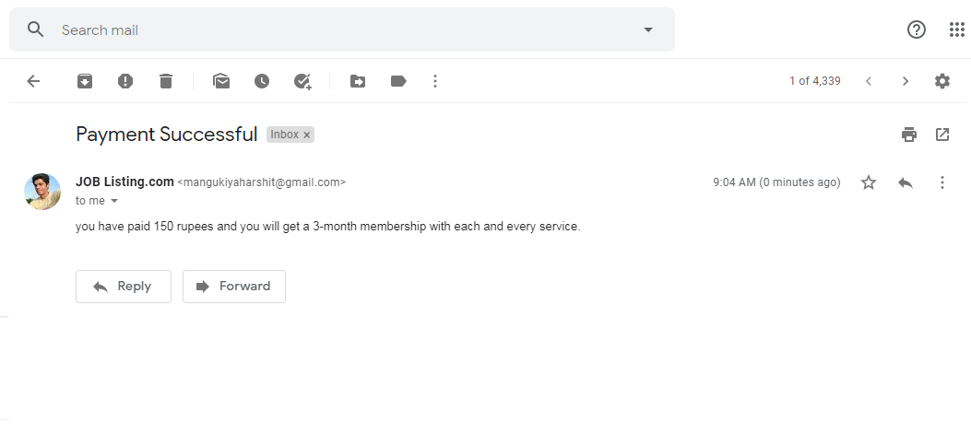
Fig 8. Email Screen

Slide 26
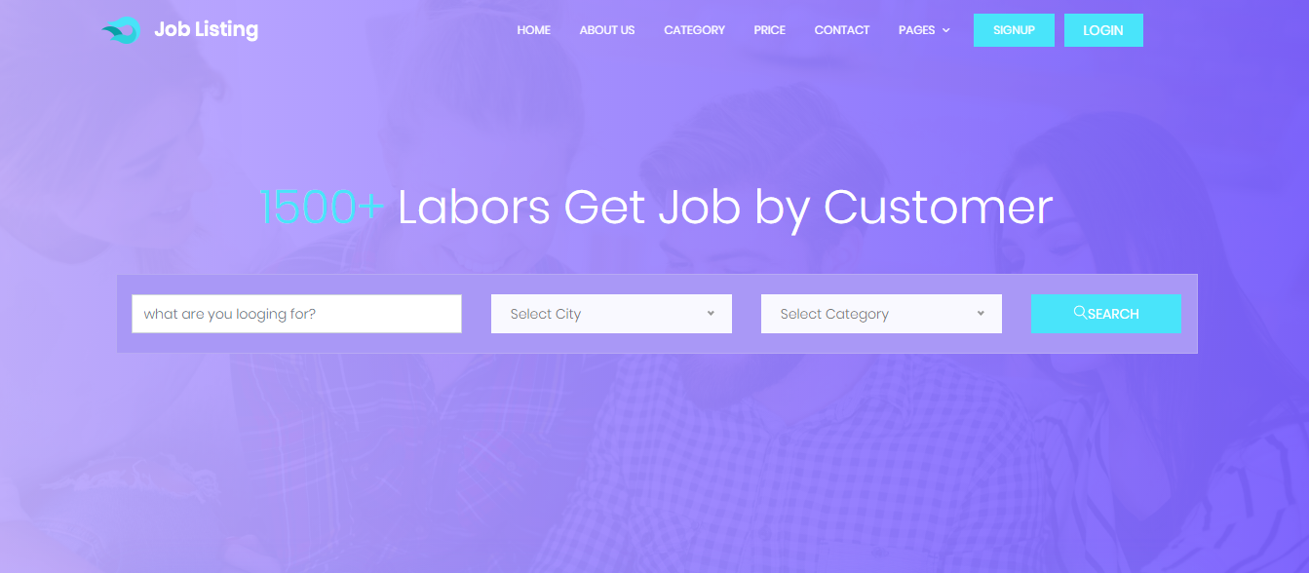
Fig 9. Home Screen

Slide 27
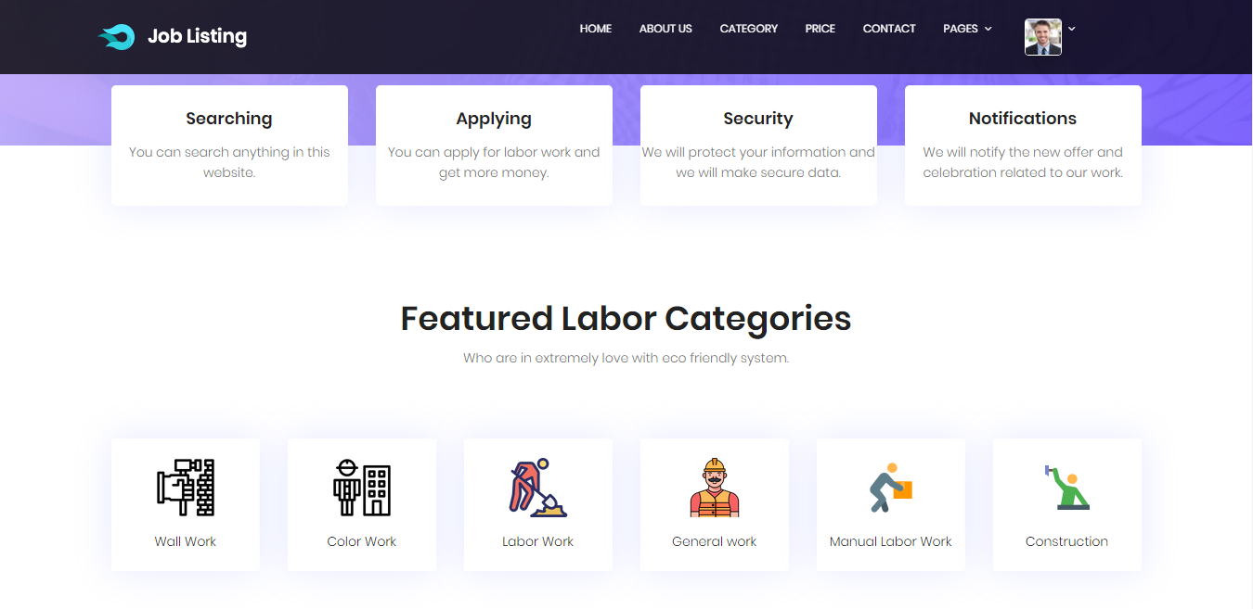
Fig 10. Home Screen

Slide 28
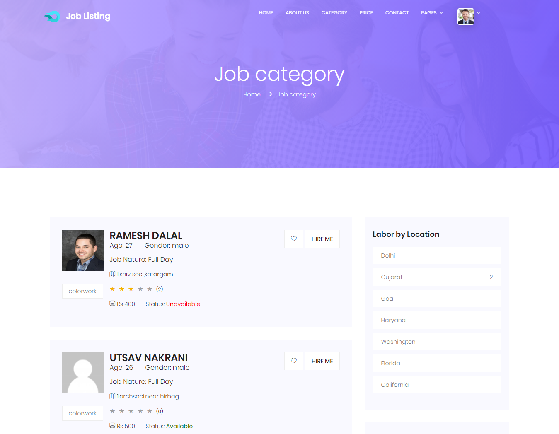
Fig 11. Category Screen

Slide 29
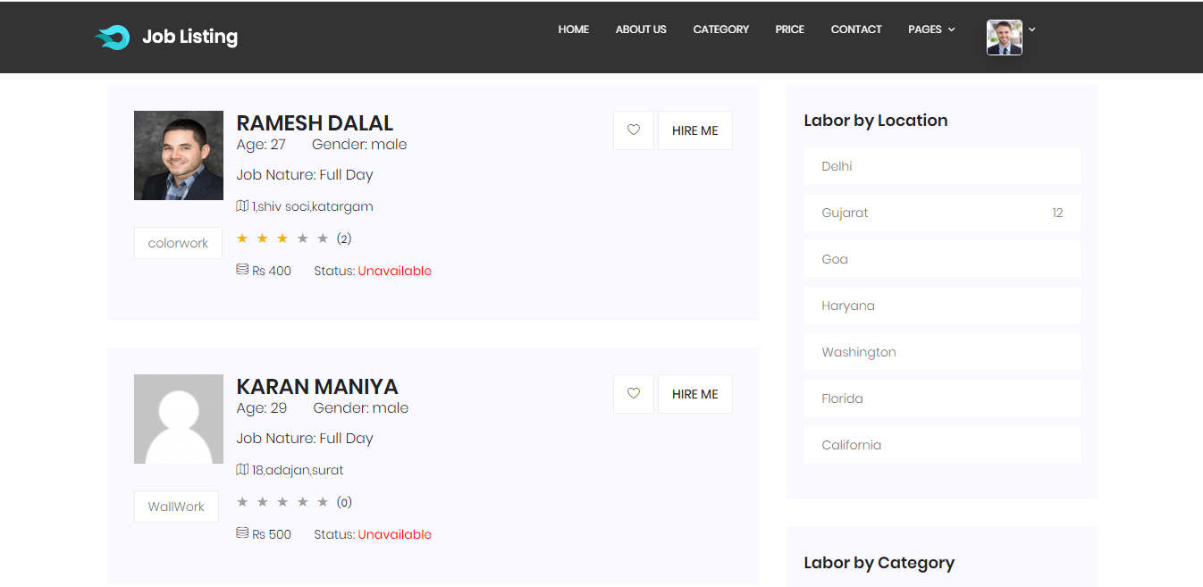
Fig 12. Home Screen

Slide 30
Fig 12. Home Screen

Slide 31
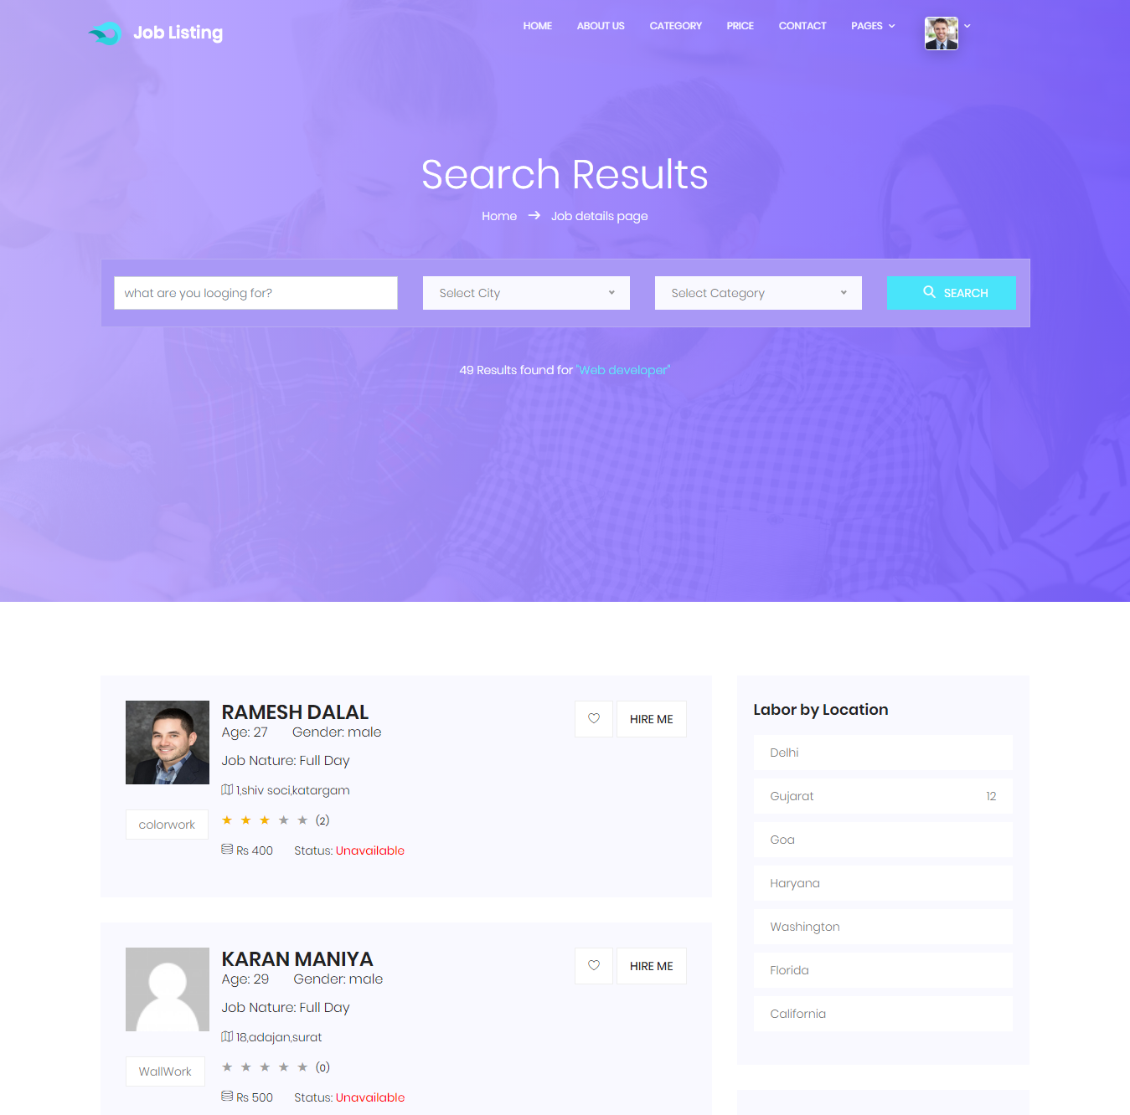
Fig 13. Search Result Screen

Slide 32
Fig 13. Search Result Screen

Slide 33
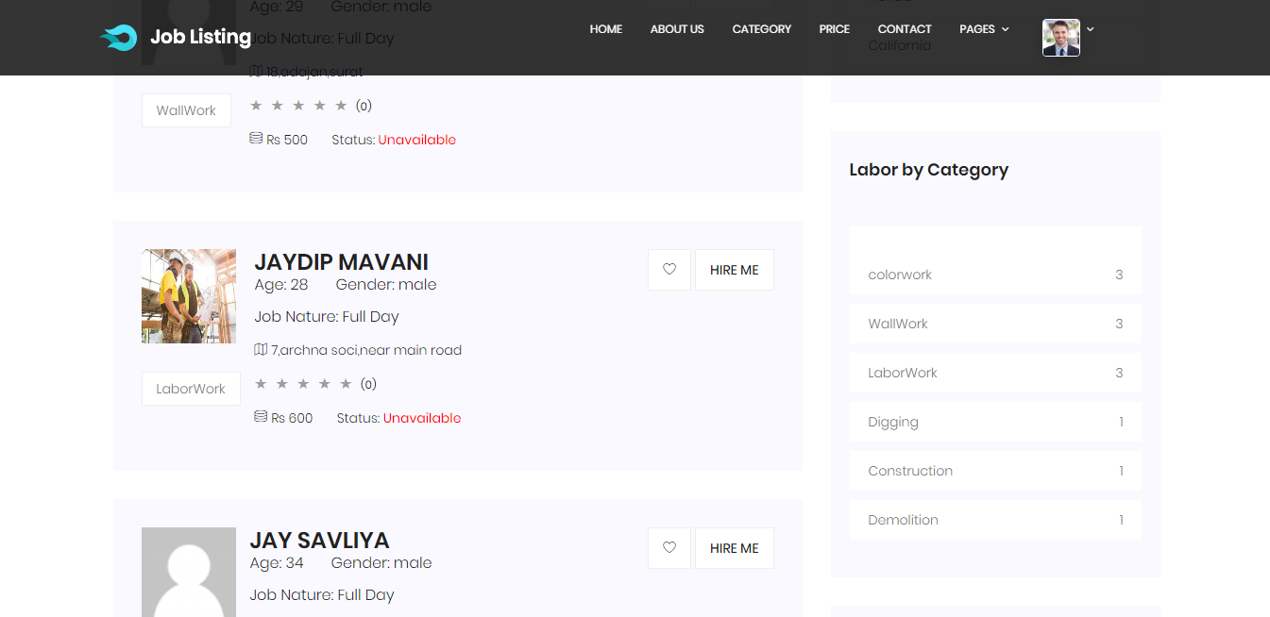
Fig 14. Home Screen

Slide 34
Fig 15. Category Screen

Slide 35
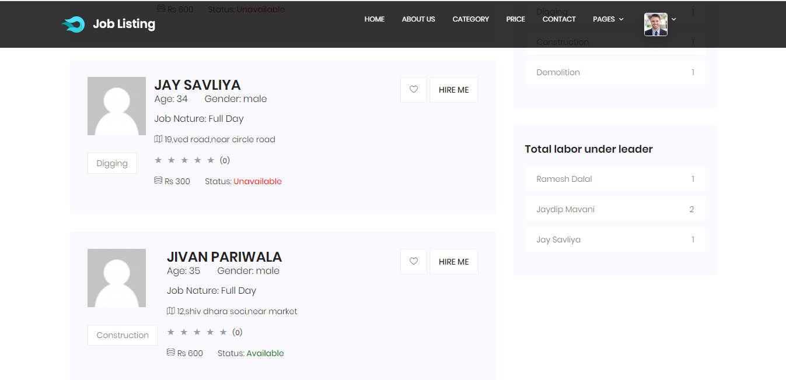
Fig 16. Home Screen

Slide 36
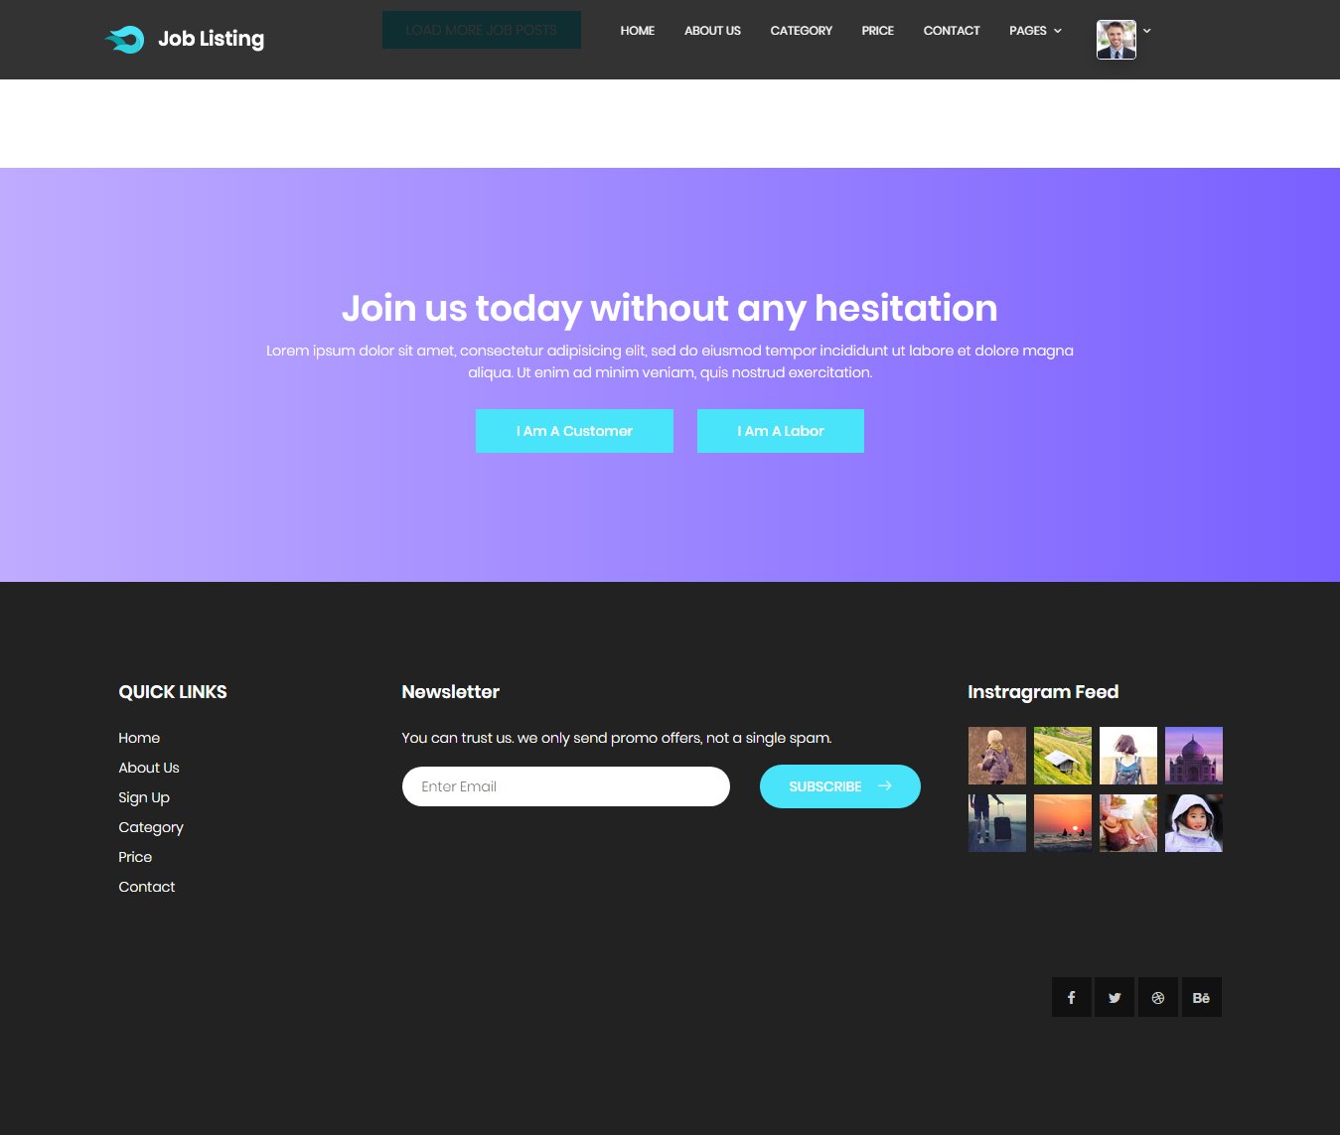
Fig 17. Home Screen Footer

Slide 37
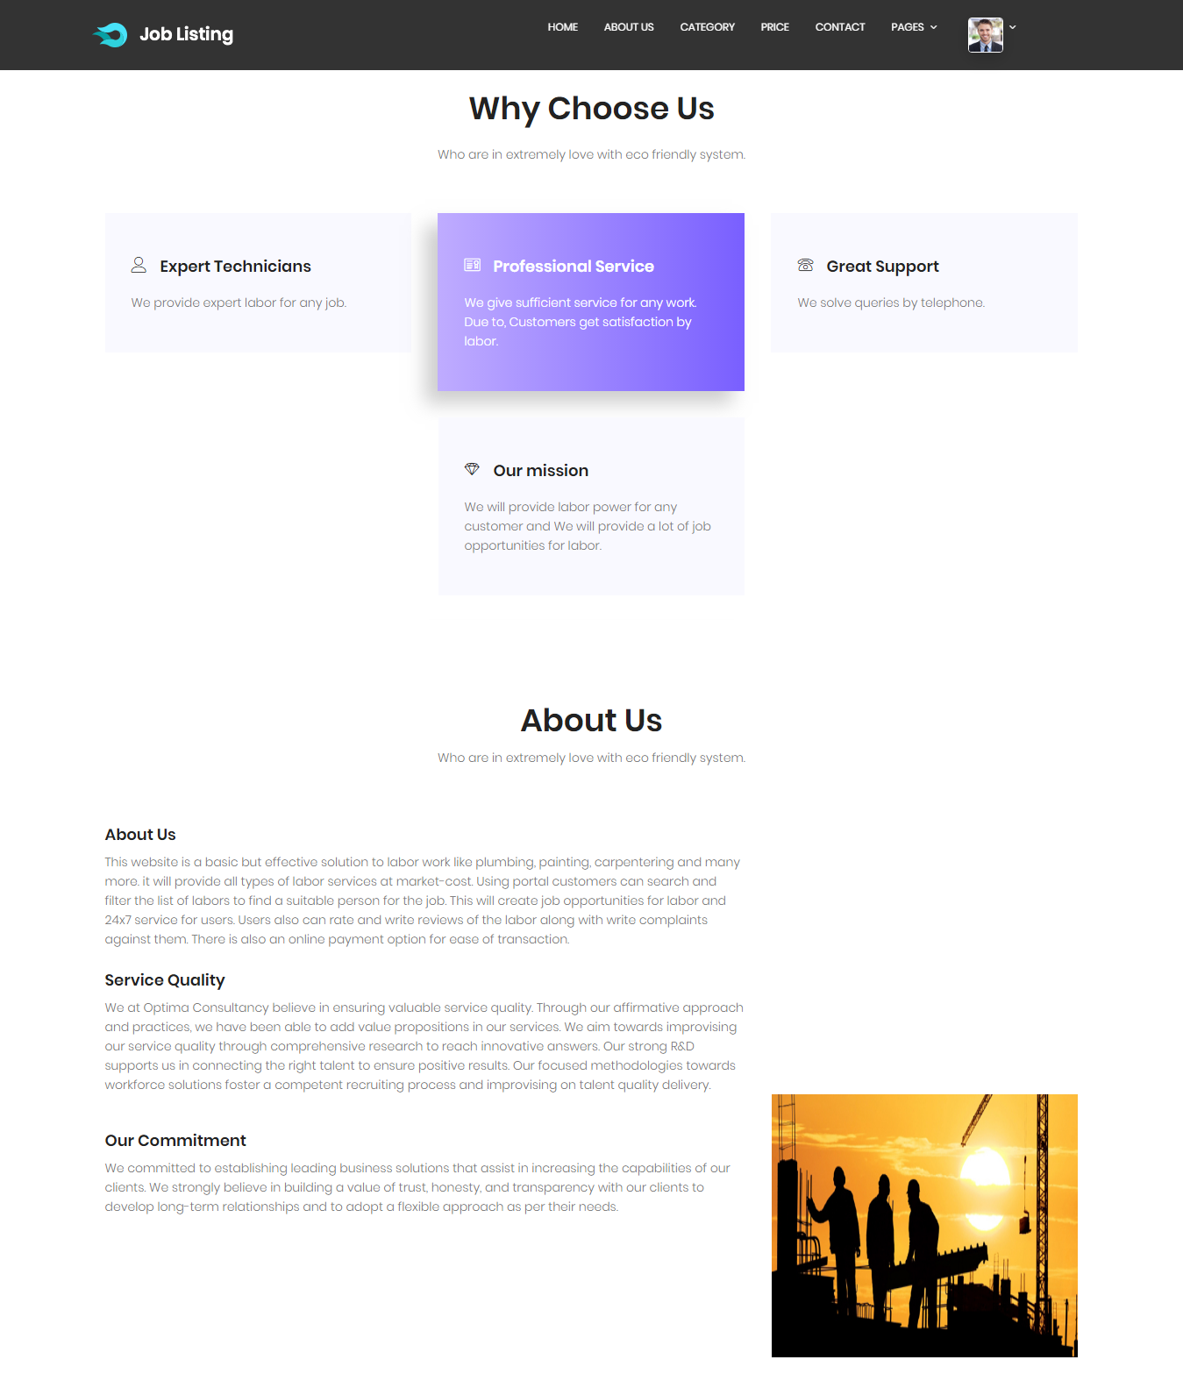
Fig 18. About Us Screen

Slide 38
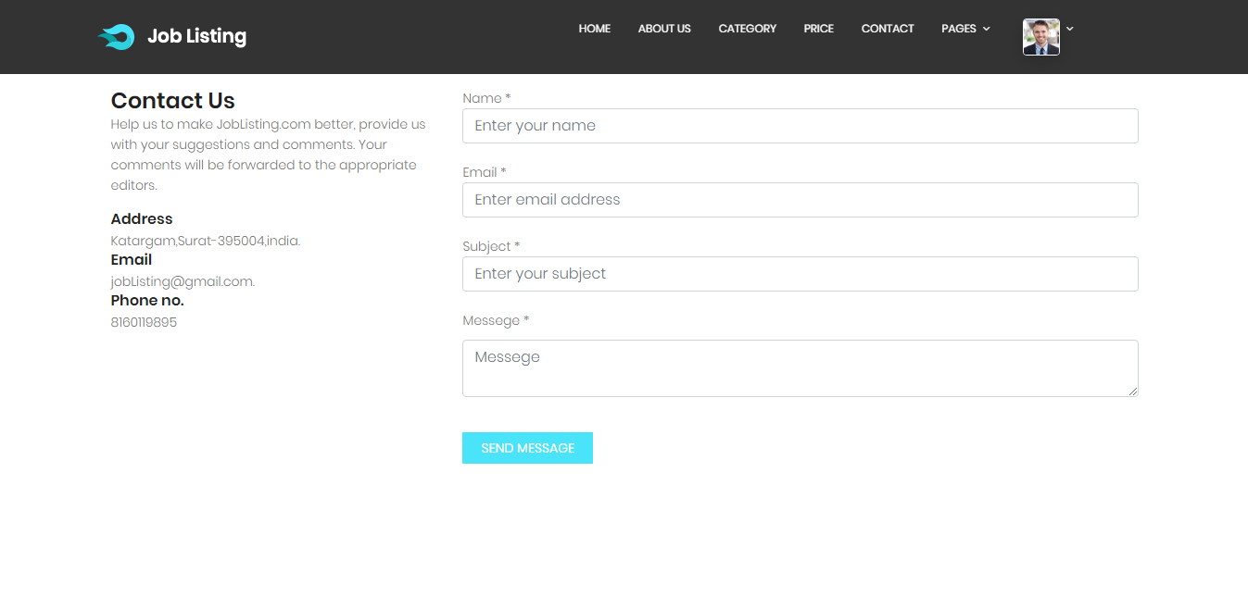
Fig 19. Contact Us Screen

Slide 39
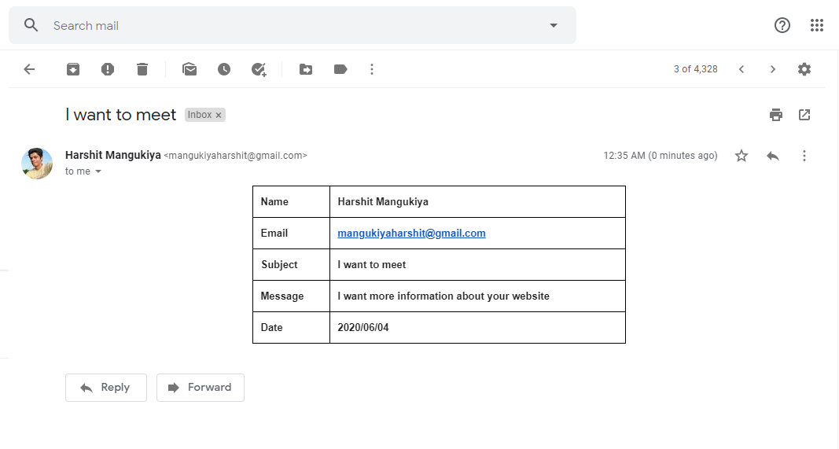
Fig 20. Email Screen

Slide 40
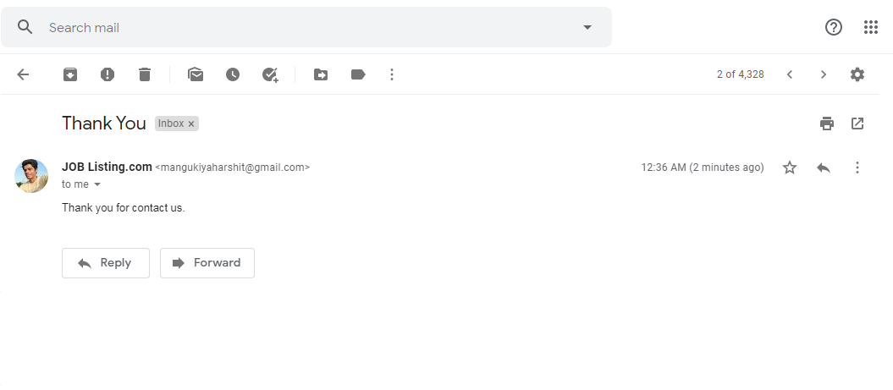
Fig 21. Email Screen

Slide 41
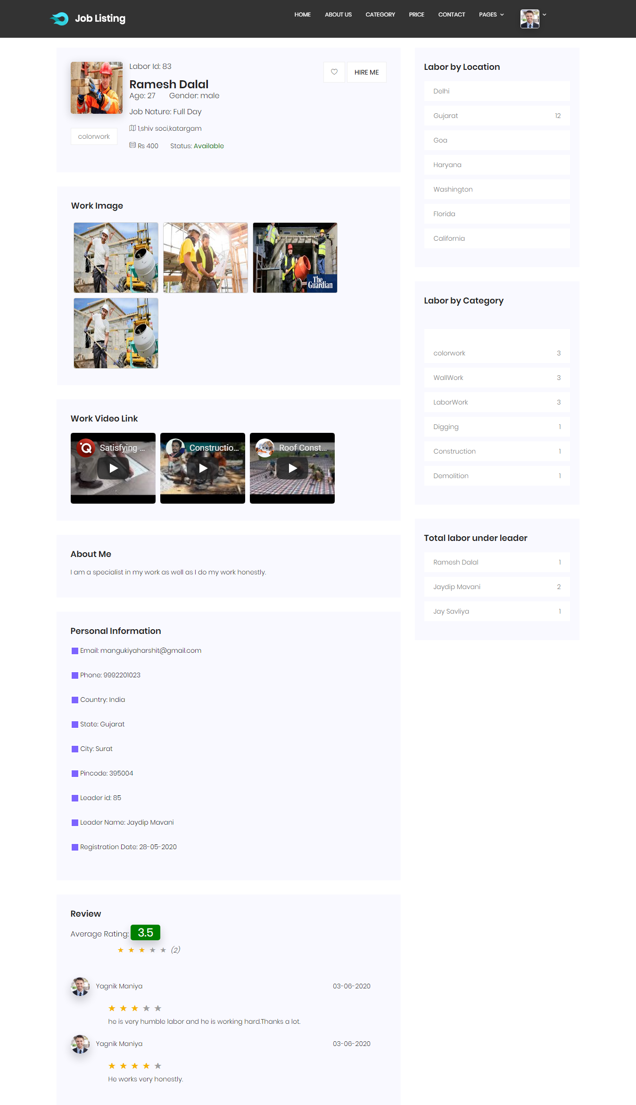
Fig 22. Labor Details Screen

Slide 42
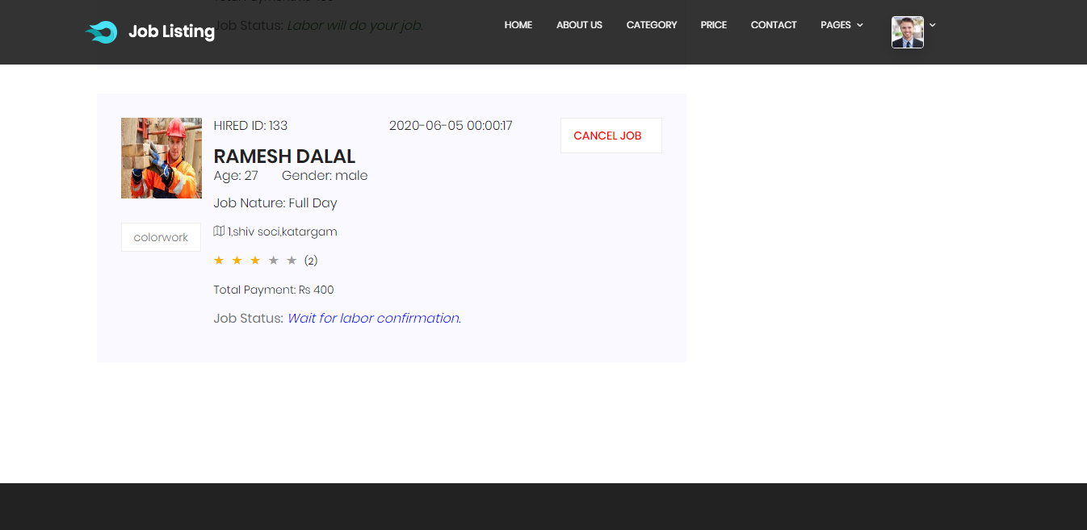
Fig 23. Hired Labor Detail Screen

Slide 43
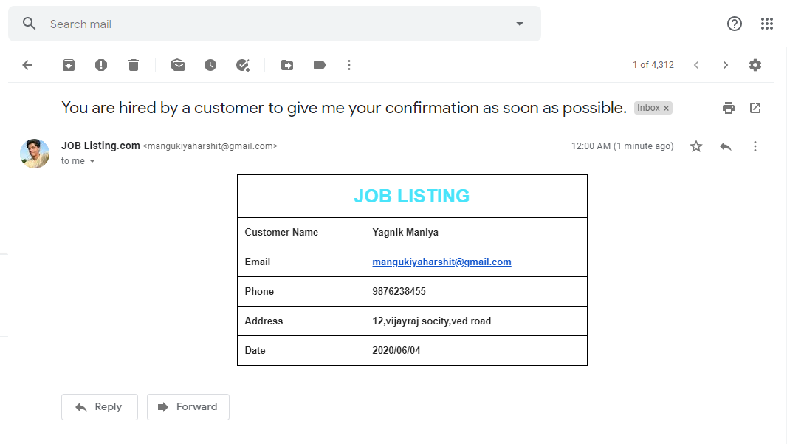
Fig 24. Email Screen

Slide 44
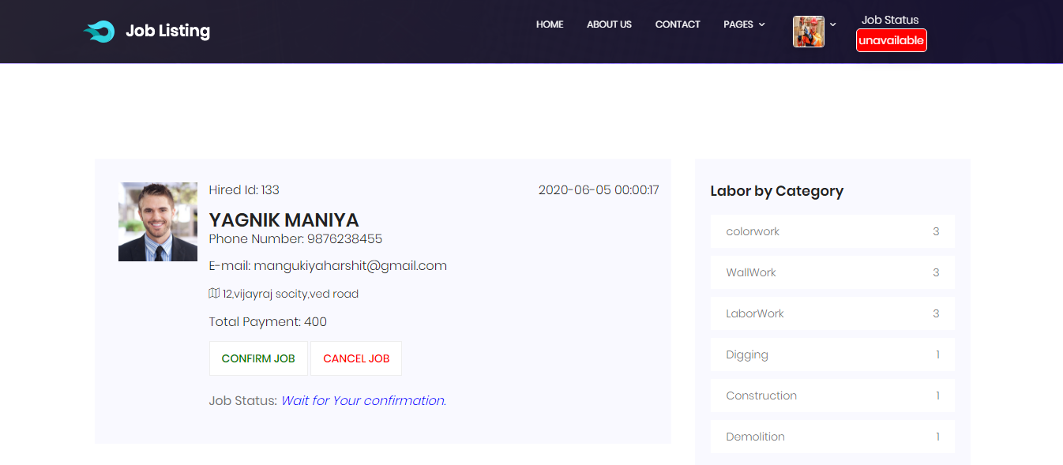
Fig 25. Labor Home Screen

Slide 45
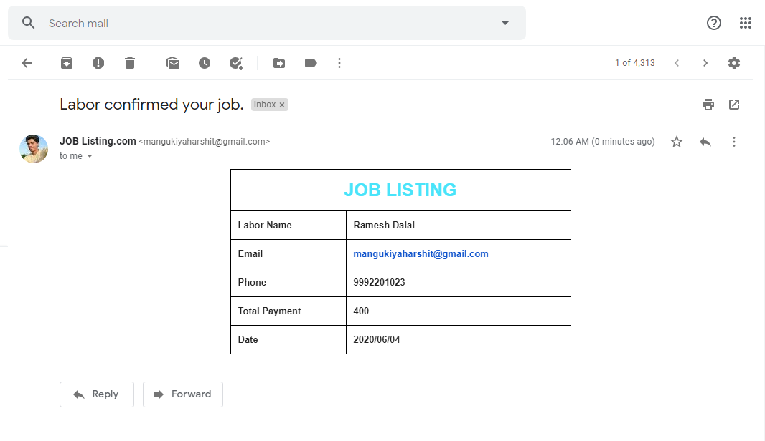
Fig 26. Email Screen

Slide 46
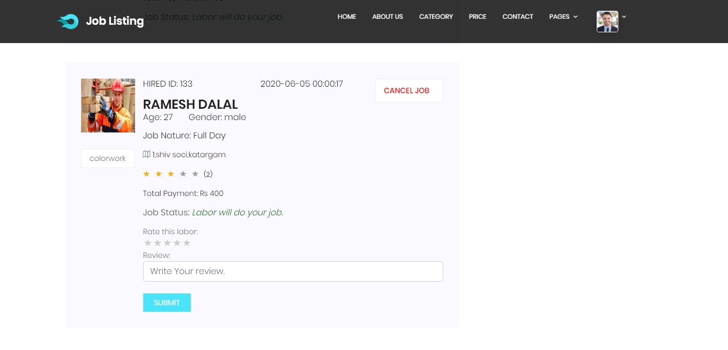
Fig 27. Hired Labor Detail Screen

Slide 47
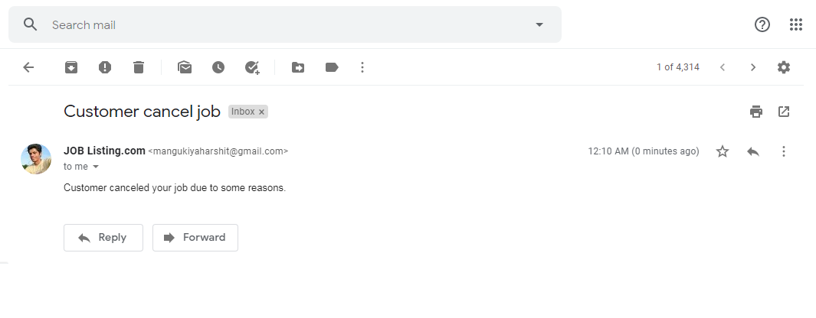
Fig 28. Email Screen

Slide 48
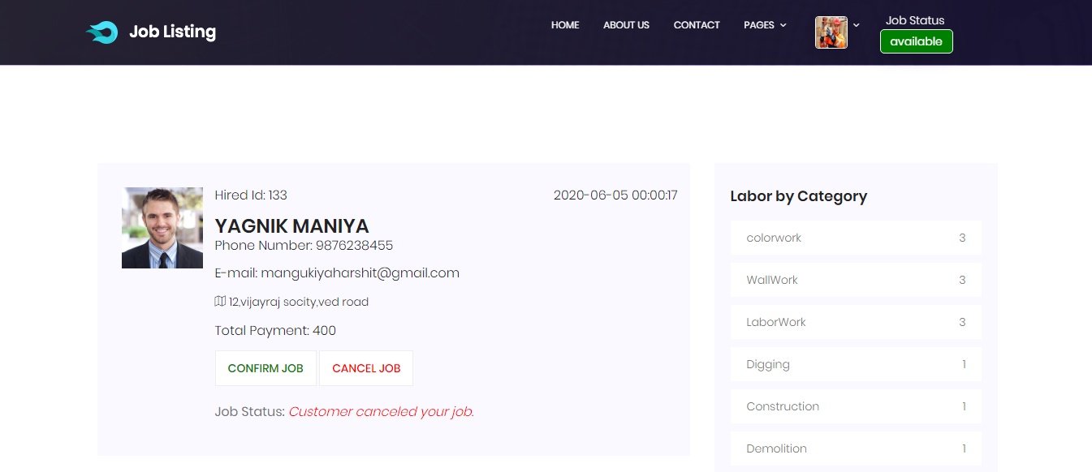
Fig 29. Labor Home Screen

Slide 49
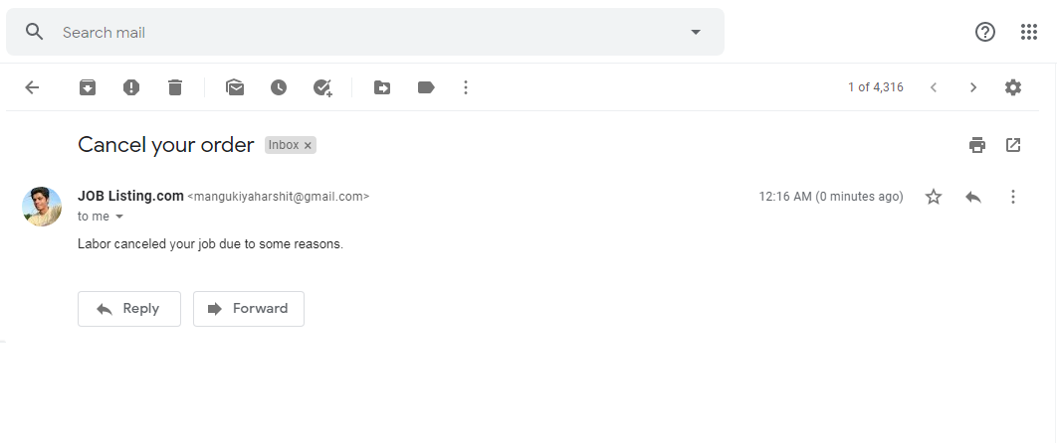
Fig 30. Email Screen

Slide 50
Fig 30. Email Screen

Slide 51
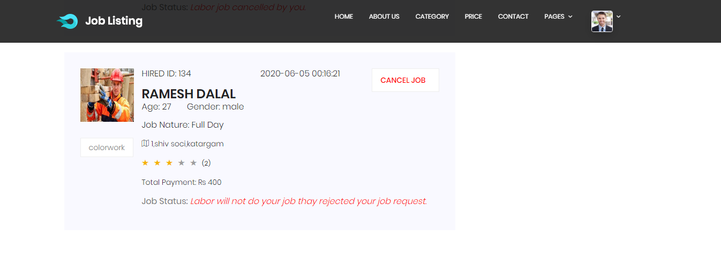
Fig 31. Hired Labor Detail Screen

Slide 52
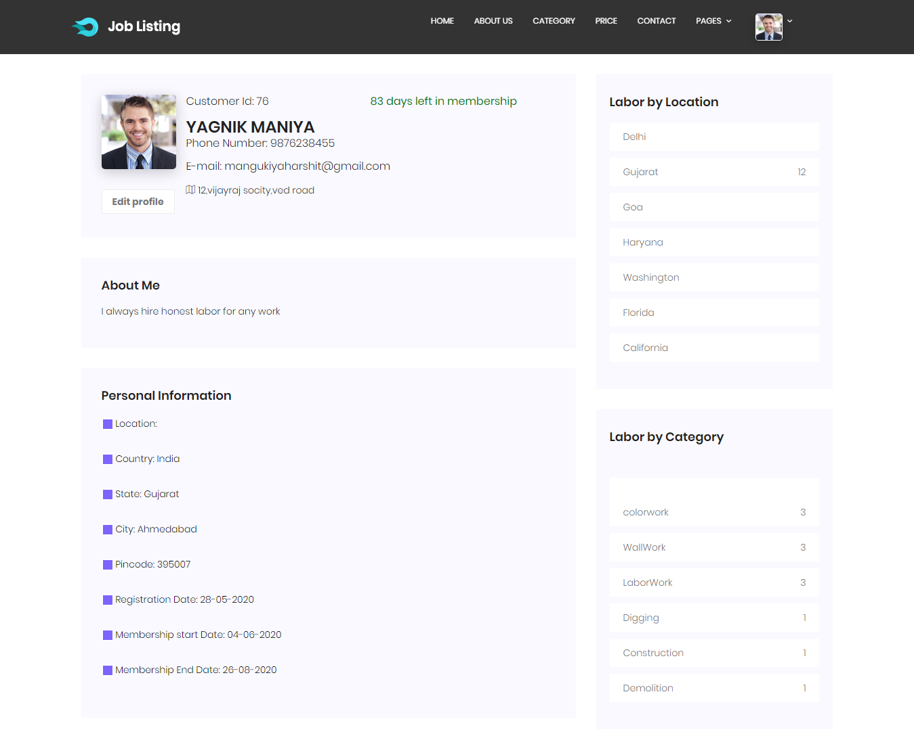
Fig 32. Customer Profile Screen

Slide 53
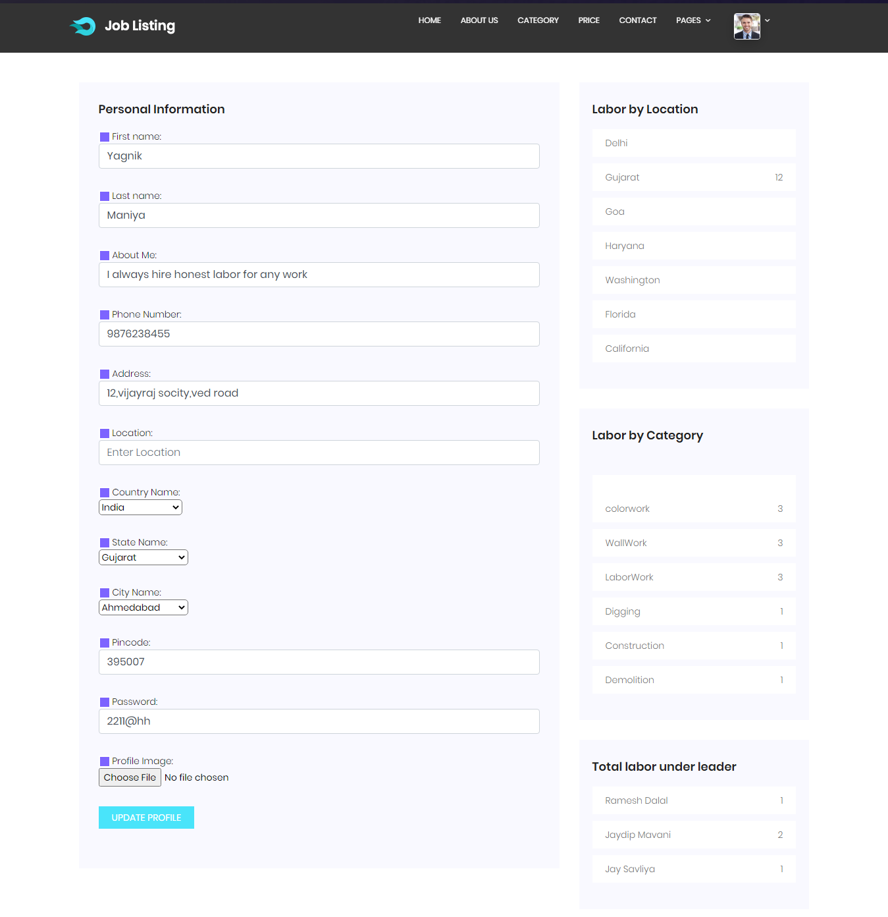
Fig 33. Edit Customer Profile Detail Screen

Slide 54
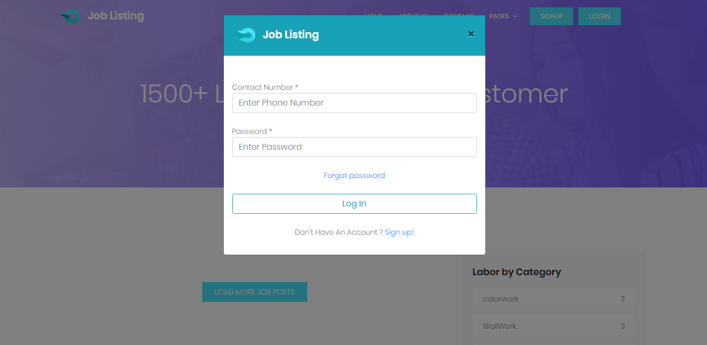
Fig 34. Labor Login Screen

Slide 55
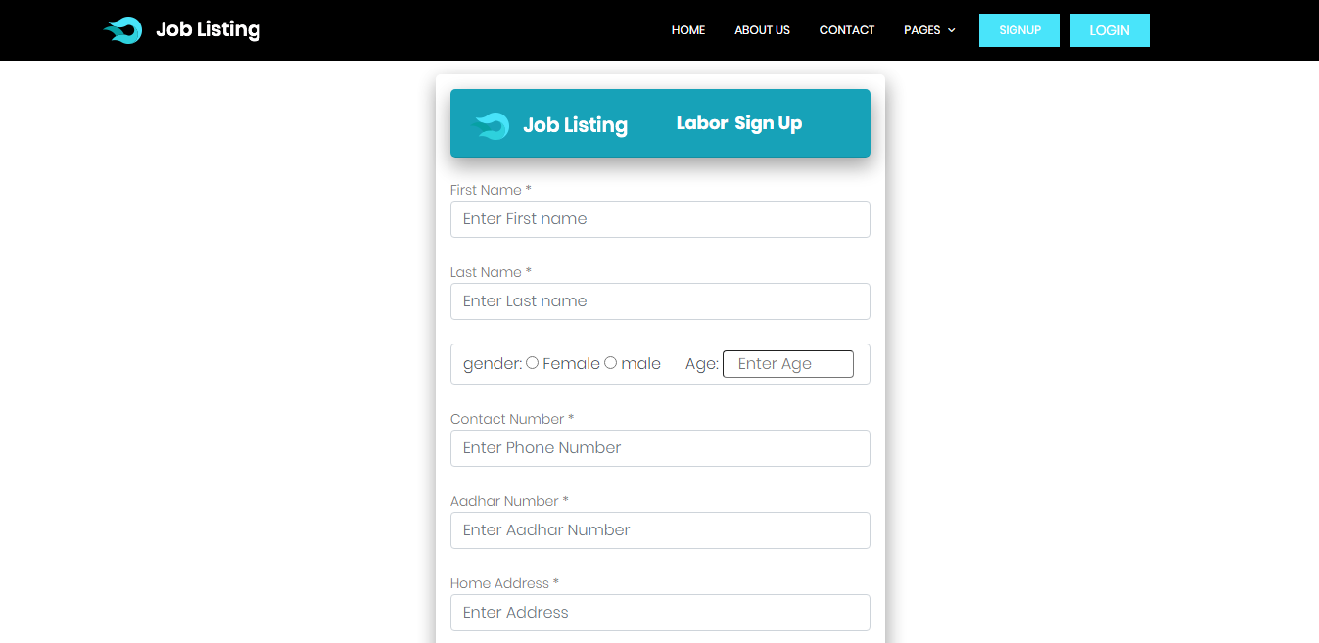
Fig 35. Labor Sign Up Screen

Slide 56
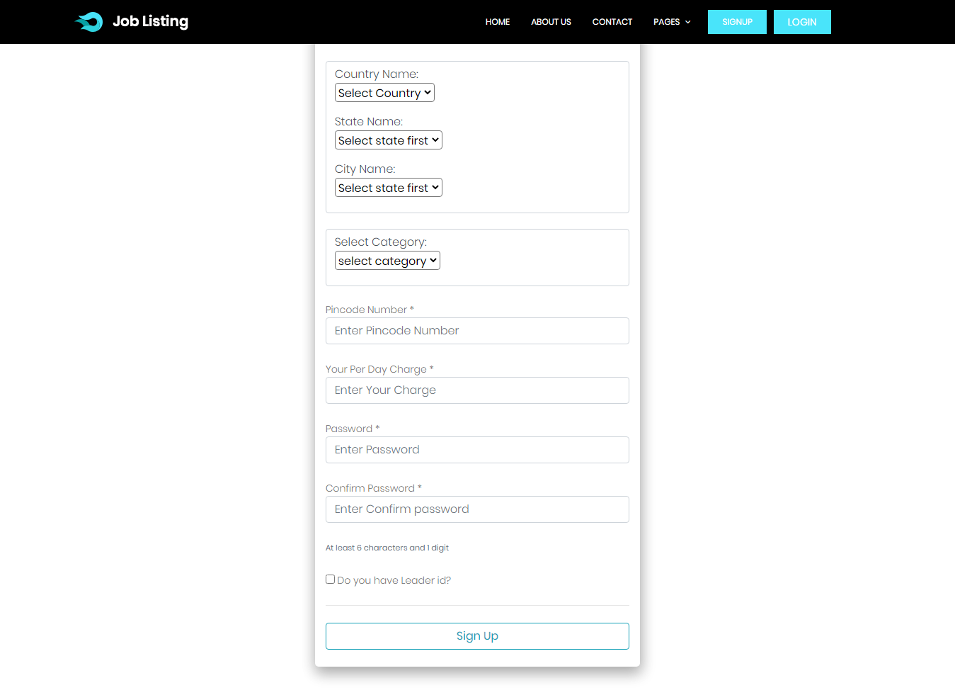
Fig 36. Labor Sign Up Screen

Slide 57
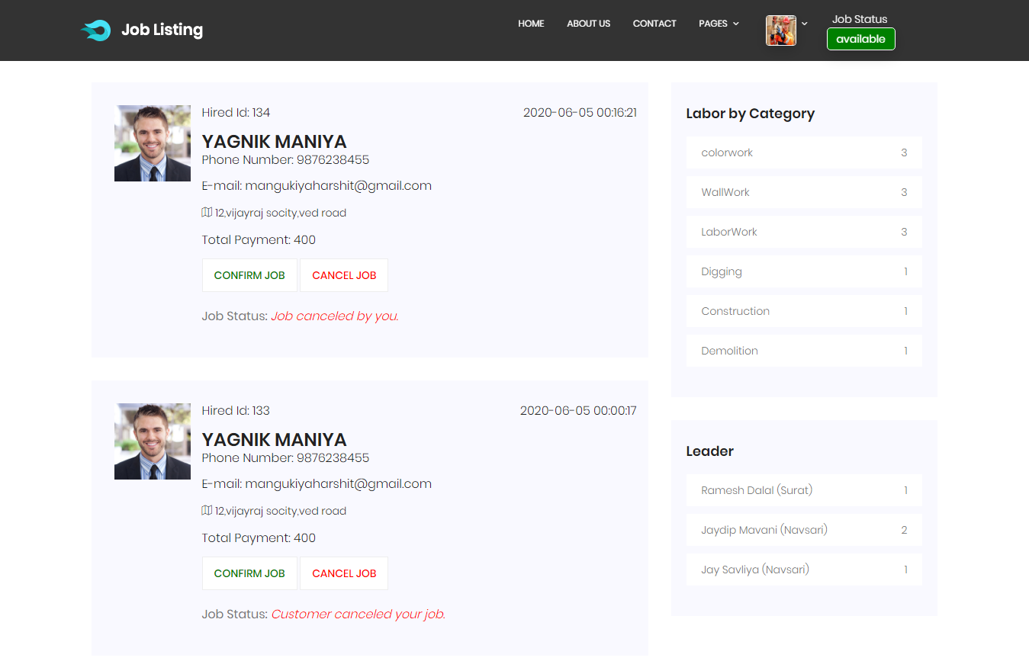
Fig 37. Labor Home Screen

Slide 58
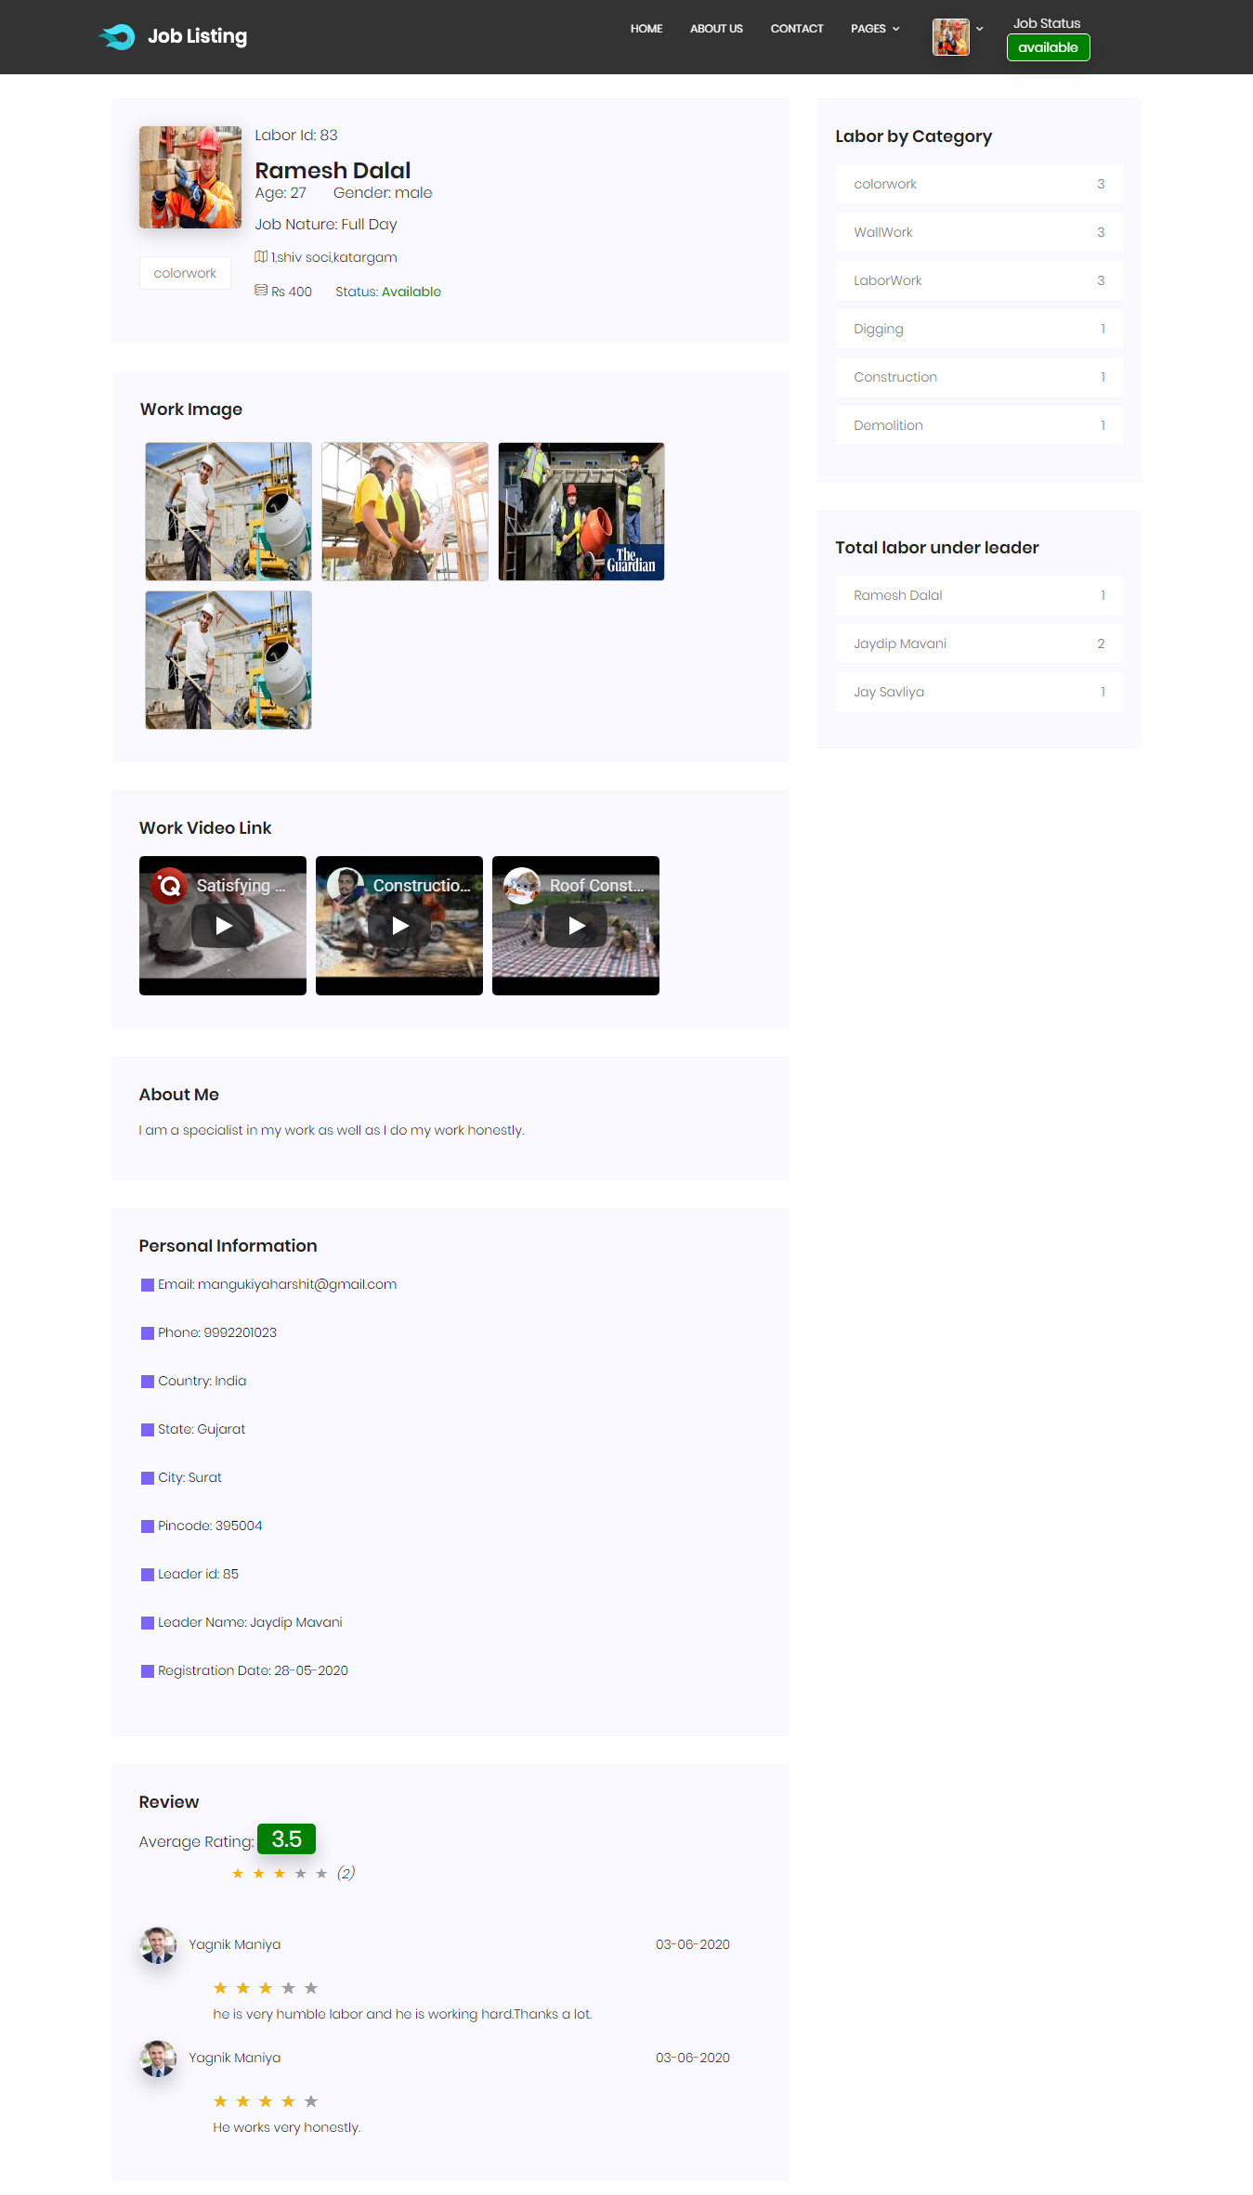
Fig 38. Leader Profile Detail Screen

Slide 59
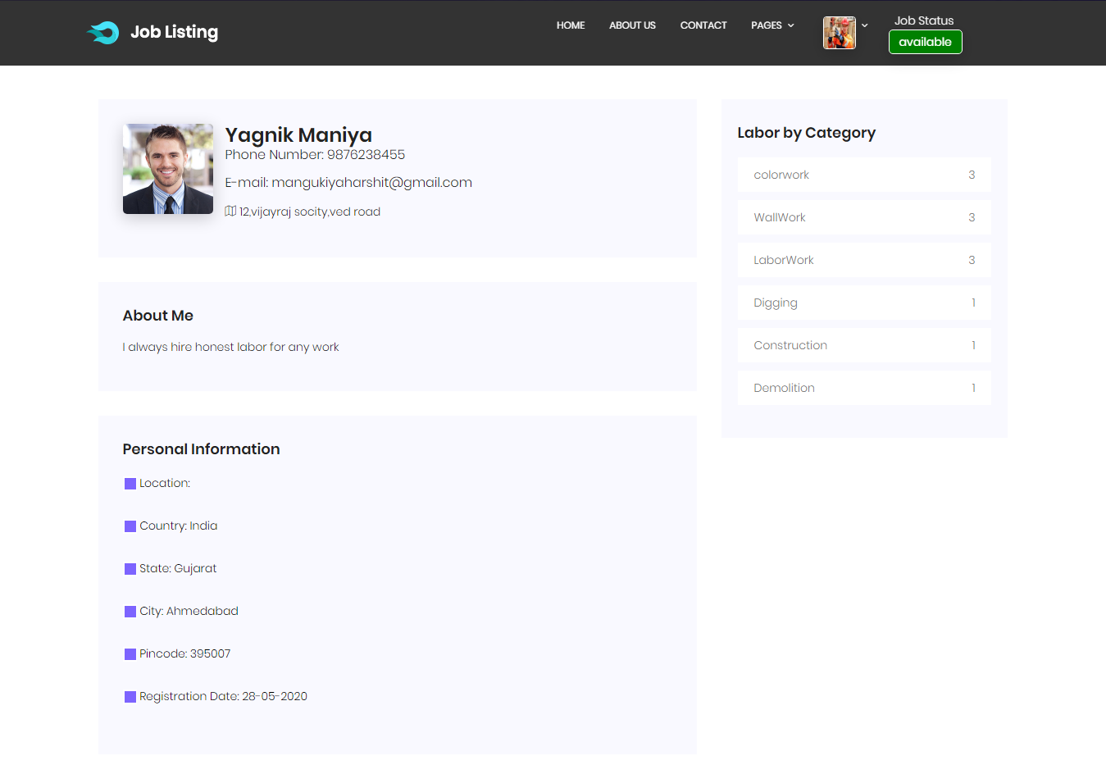
Fig 39. Customer Detail Screen

Slide 60
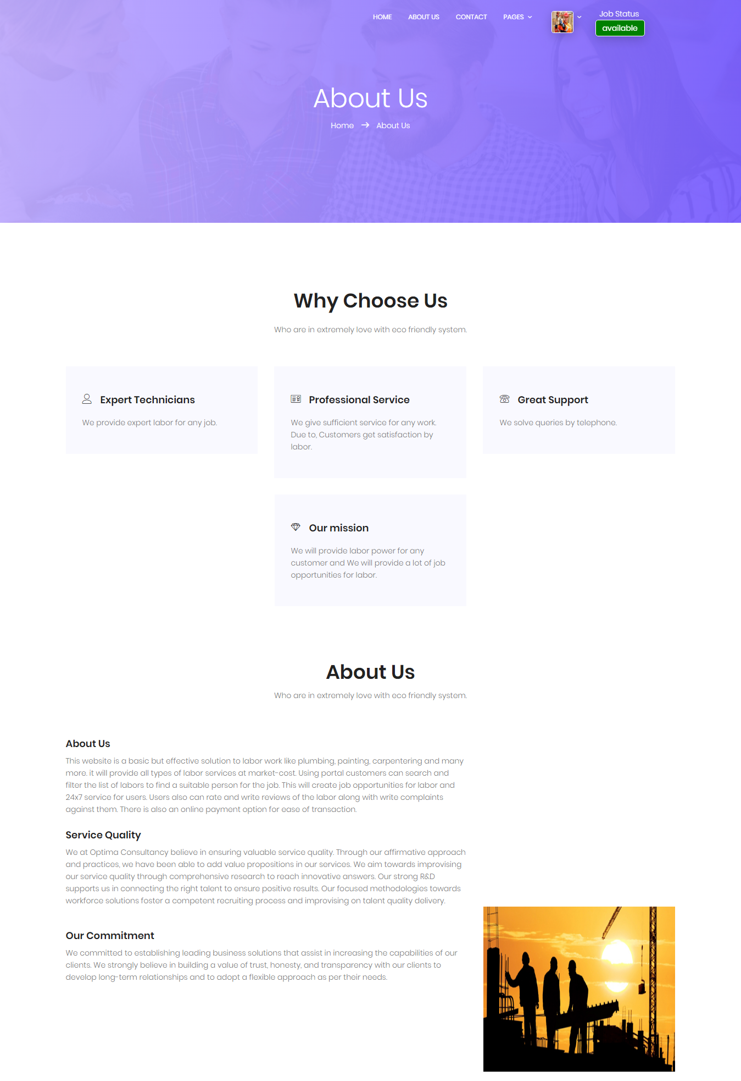
Fig 40. About us Screen

Slide 61
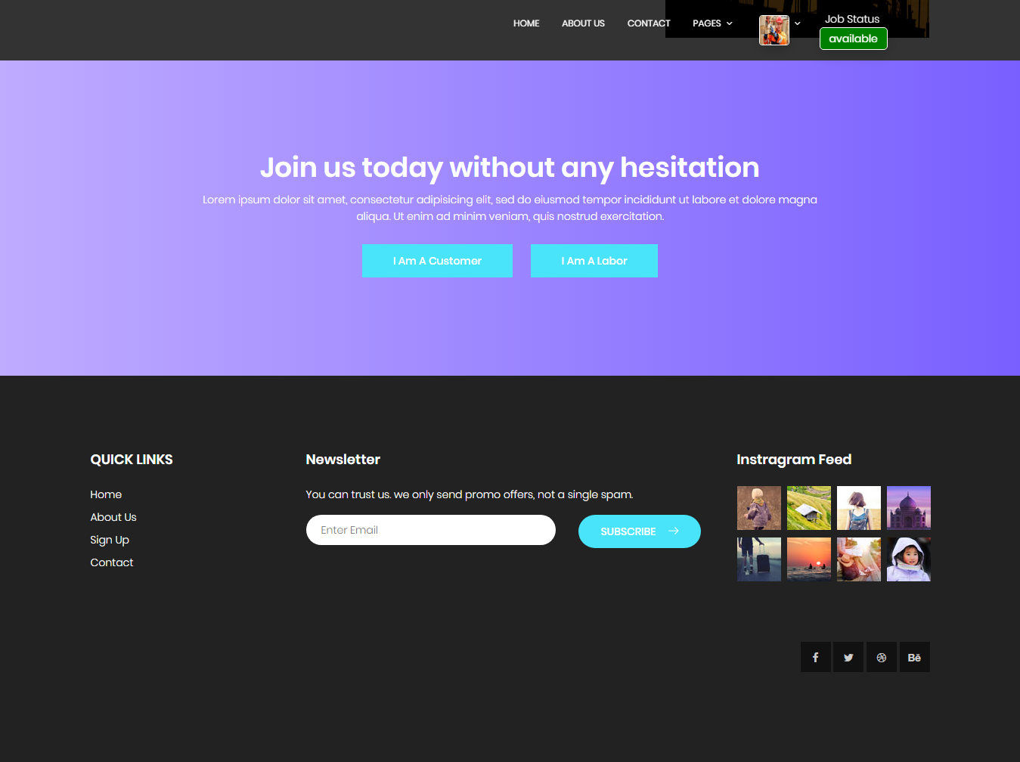
Fig 41. Labor Home Screen Footer

Slide 62
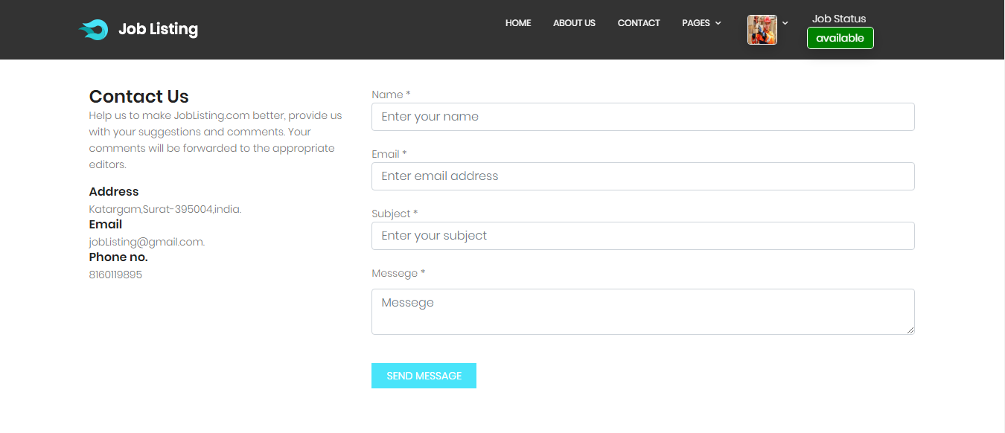
Fig 42. Contact Us Screen

Slide 63
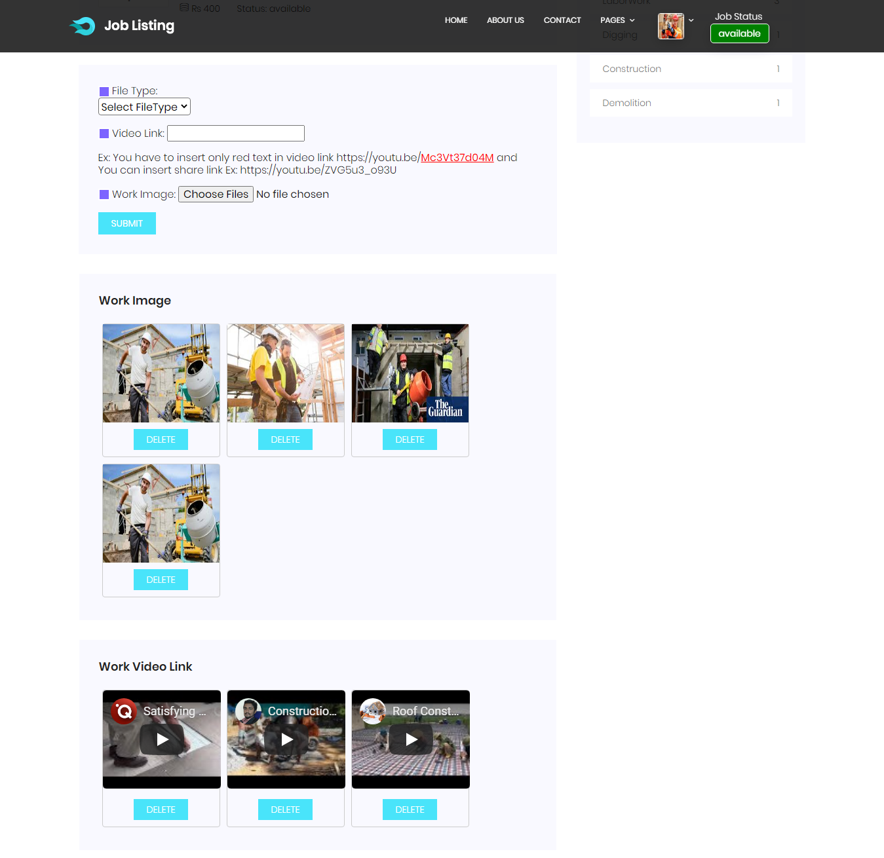
Fig 43. Labor Profile Screen

Slide 64
Fig 43. Labor Profile Screen

Slide 65
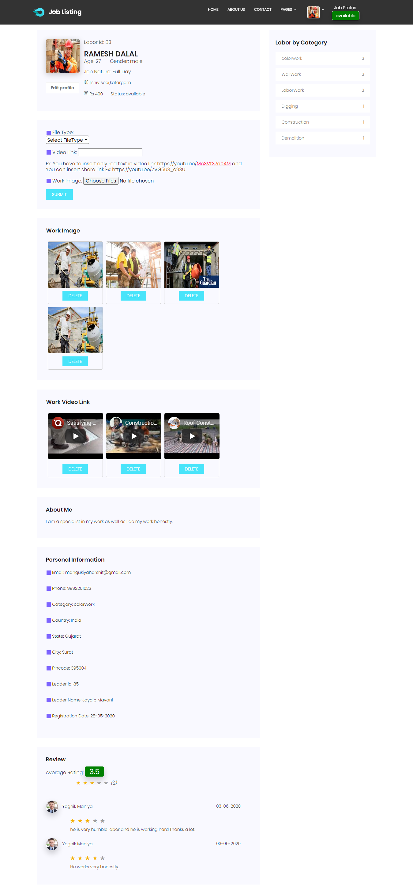
Fig 44. Labor Profile Screen

Slide 66
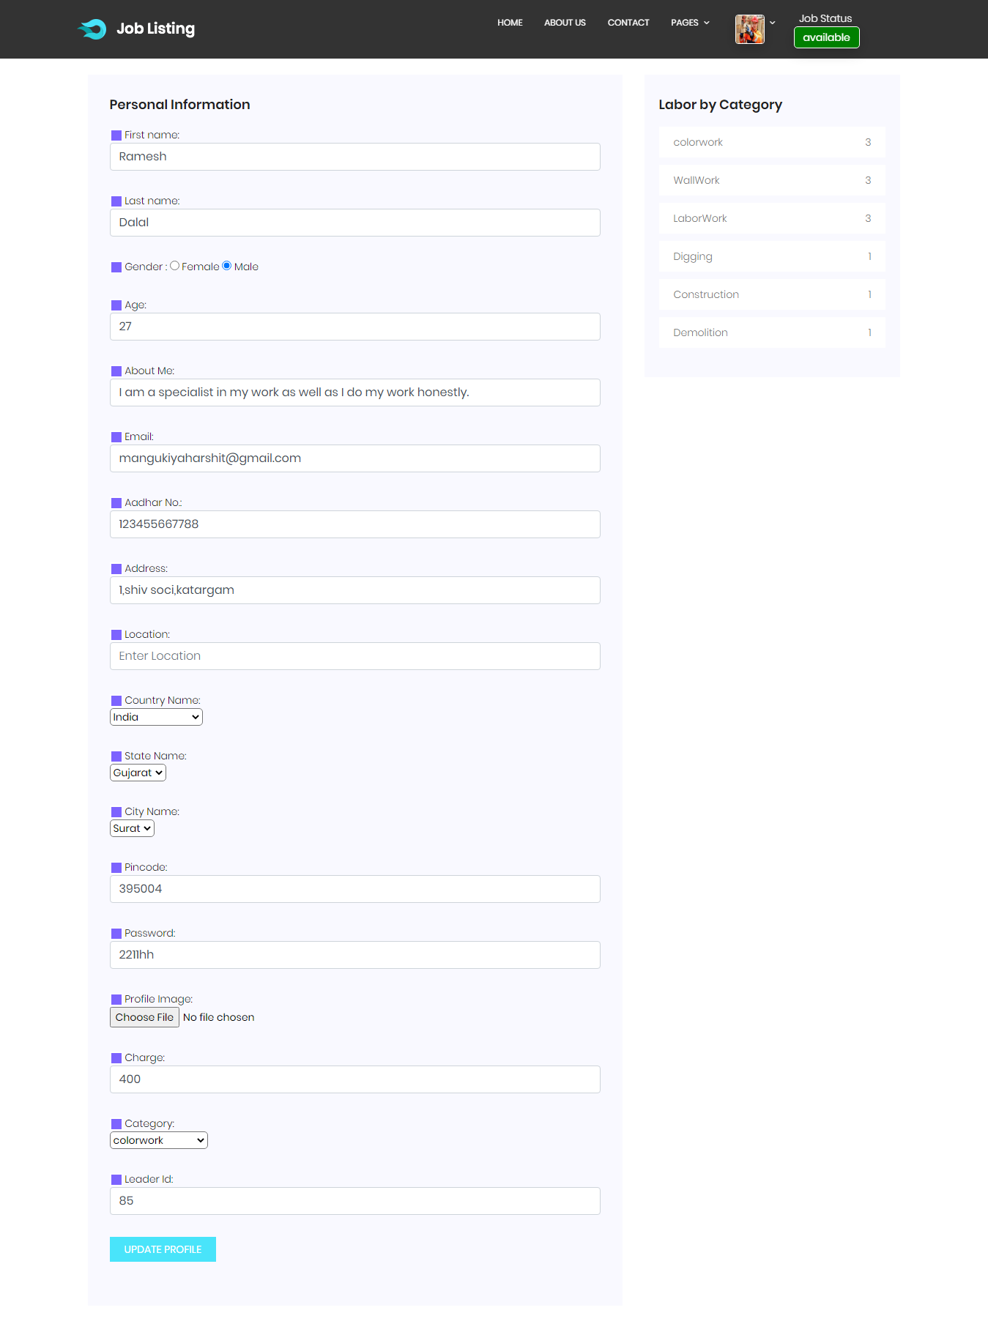
Fig 45. Edit Labor Detail Screen

Slide 67
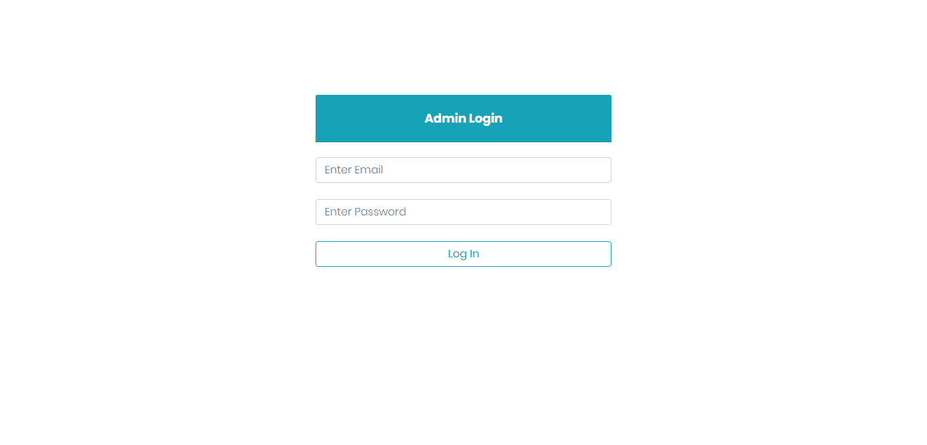
Fig 46. Admin Login Screen

Slide 68
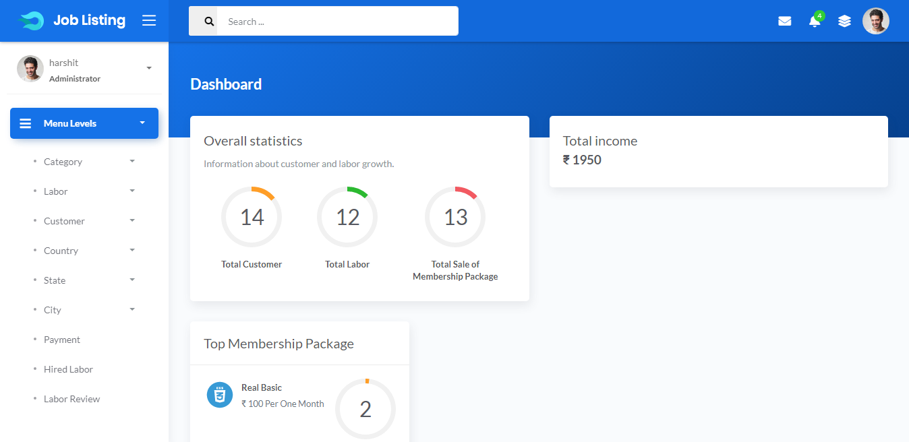
Fig 47. Home Screen

Slide 69
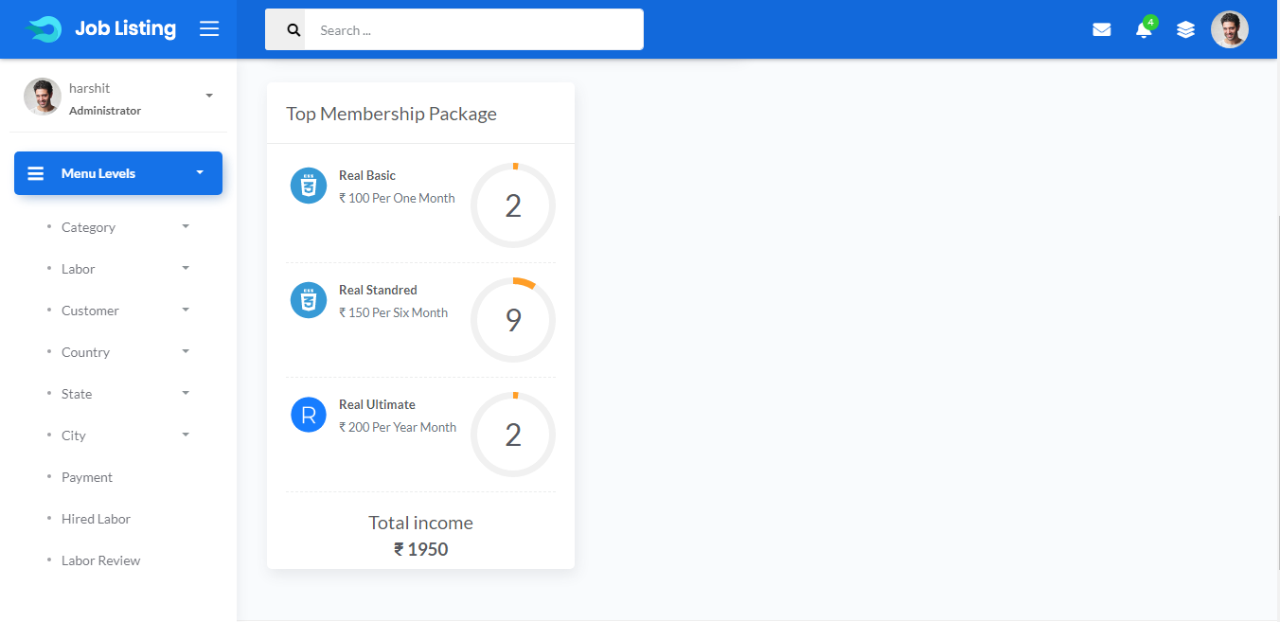
Fig 48. Home Screen

Slide 70
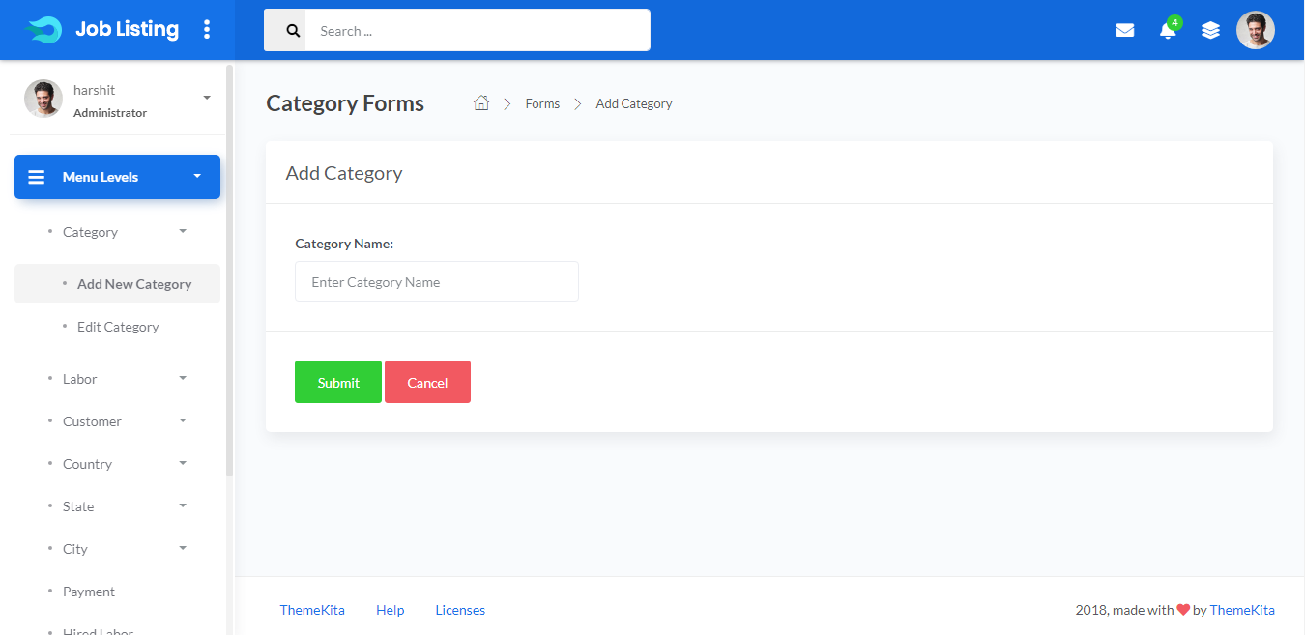
Fig 49. Add New Category Screen

Slide 71
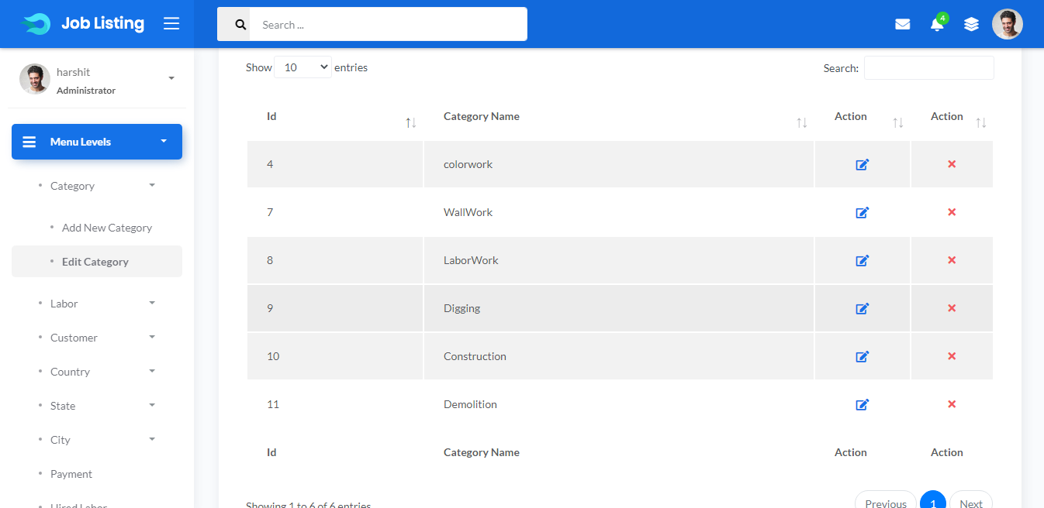
Fig 50. Edit Category Screen

Slide 72
Fig 51. Add New Labor Screen
Labor Screen

Slide 73
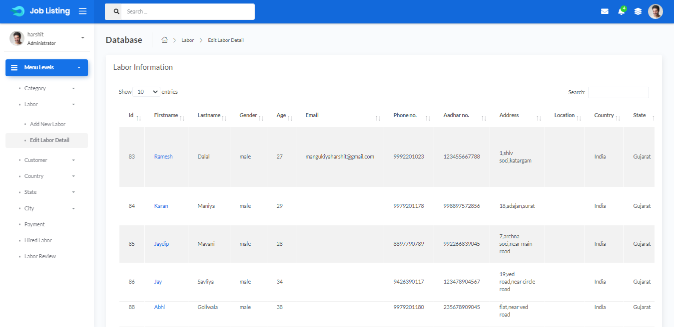
Fig 51. Edit Labor Screen

Slide 74

Fig 52. Edit Labor Screen

Slide 75

Fig 53. Labor Profile Screen

Slide 76

Fig 54. Labor Profile Screen

Slide 77

Fig 55. Labor Profile Screen

Slide 78
Fig 56. Add New Customer Screen
Customer Screen

Slide 79

Fig 57. Edit Customer Screen

Slide 80

Fig 58. Edit Customer Screen

Slide 81

Fig 59. Customer Profile Screen

Slide 82

Fig 60. Add New Country Screen

Slide 83

Fig 61. Edit Country Screen

Slide 84

Fig 62. Add New State Screen

Slide 85

Fig 63. Edit State Screen

Slide 86

Fig 64. Add New City Screen

Slide 87

Fig 65. Edit City Screen

Slide 88

Fig 66. Payment Screen

Slide 89

Fig 67. Admin

Slide 90

Fig 68. Review/Rating Screen

Slide 91
References
https://www.udemy.com/
https://stackoverflow.com/
https://www.php.net/manual/en/
https://www.youtube.com/

Slide 92
Thank You

